Slide 1



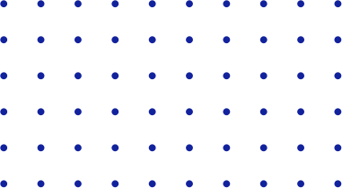


YOLO
Basic Terminologies
Part Two The Structure of YOLO

Slide 2



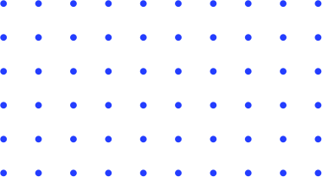

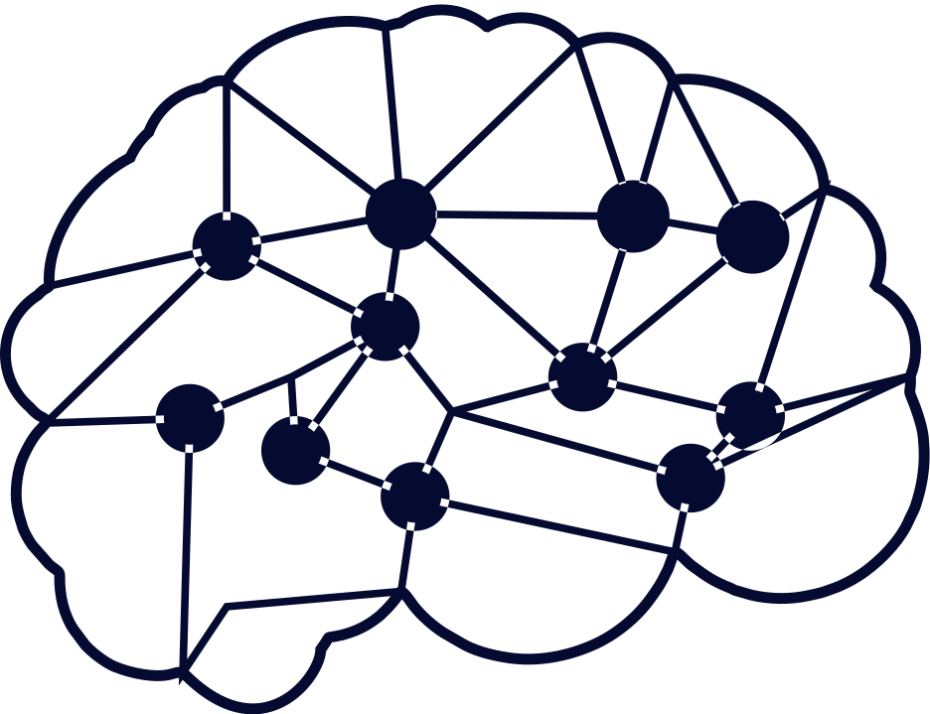
Abilities
01
Activation Functions
03
IOU and NMS
02
Backbone-Neck-Head
04
Mean Average Precision

Slide 3
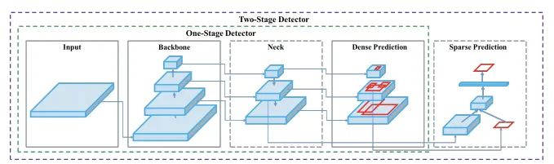
Backbone-Neck-Head

Slide 4


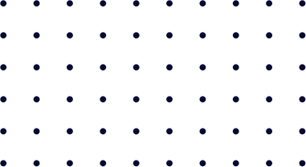


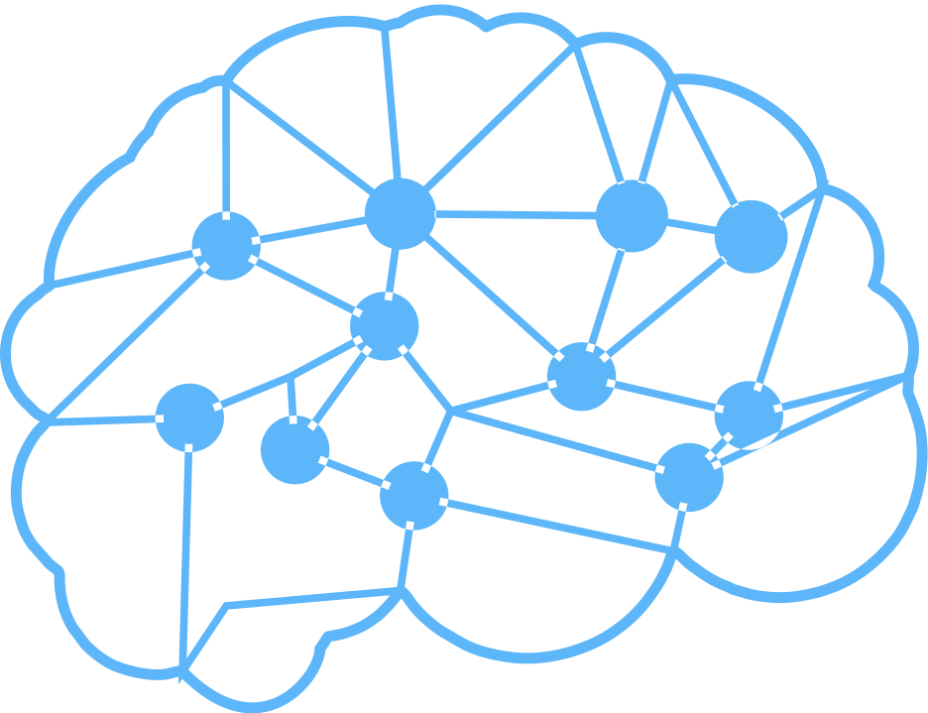
Backbone
A convolutional neural network that accumulates and produces visual features with different shapes and sizes.
It basically acts as a feature extractor.
Classification models like ResNet, VGG, and EfficientNet are used as feature extractors.
Darknet acted as a backbone for YOLO v2 and v3 while CSPNet was introduced in YOLO v4.

Slide 5
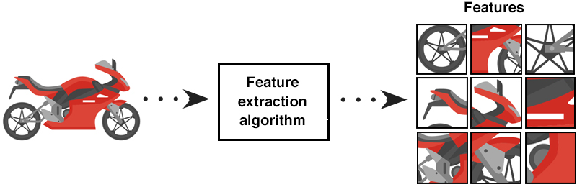
Feature extraction is a technique used to reduce a large input data set into relevant features.

Slide 6


Backbone - Darknet
YOLO v2 introduced Darknet-19, which is a 19-layer network supplemented with 11 more layers for object detection. It has 19 convolutional layers and 5 max-pooling layers.
However, having a 30-layer architecture, YOLO v2 often struggled at detecting small objects.
Therefore, the authors introduce successive 3 × 3 and 1 × 1 convolutional layers followed by some shortcut connections allowing the network be much deeper.
Darknet-53 is much more powerful than Darknet-19. Moreover, it is more efficient than ResNet-101 or ResNet-152.
Darknet-53 better utilizes the GPU, making it more efficient to evaluate and thus faster. That’s explained by the observation that ResNets have too many layers and aren’t very efficient.

Slide 7
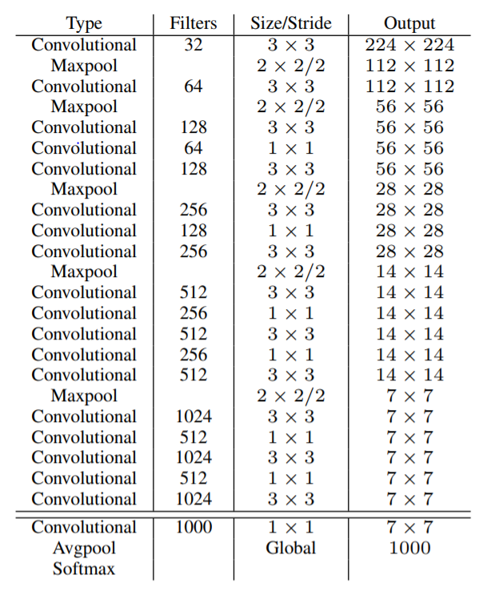
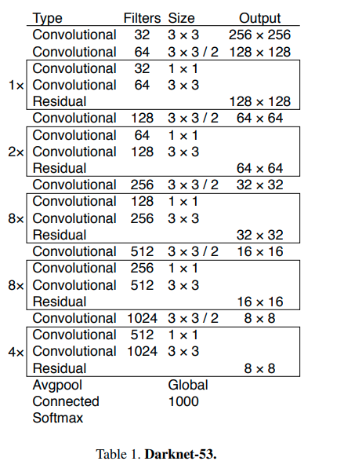
Darknet-19
Darknet-53

Slide 8
Backbone - CSPNet
CSPNet: a computationally efficient component that enable “ResNet, ResNext, DenseNet” to be deployed on both CPUs and mobile GPUs.
Richer Gradient combination while reducing the amount of computation (DenseNet).
Partitioning feature map of the base layer into two parts and then merging them through a proposed cross-stage hierarchy.
Let gradient flow propagate through different network paths by splitting the gradient flow
The propagated gradient information can have a large correlation difference by switching concatenation and transition steps -> (Better than DenseNet)

Slide 9
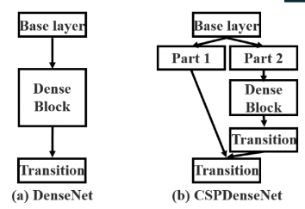
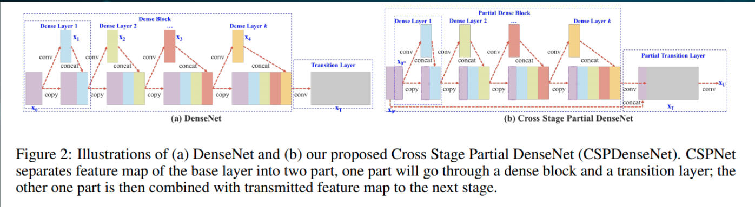

Slide 10
Advantages
Strengthening learning ability
Reducing memory costs
Lightweight versions of ResNet, ResNext, and DenseNet have sub-optimal performance.
After applying CSPNet on these backbone, the computation effort can be reduced from 10% to 20% but outperforms original backbones
Adopt cross-channel pooling to compress the feature maps during the feature pyramid generating process
Removing computational Bottleneck
Evenly distribute the amount of computation at each layer in CNN

Slide 11
Continued...
In CSPResNext50 and CSPDarknet53, the DenseNet has been edited to separate the feature map of the base layer by copying it and sending one copy through the dense block and sending another straight on to the next stage.
The idea with the CSPResNext50 and CSPDarknet53 is to remove computational bottlenecks in the DenseNet and improve learning by passing on an unedited version of the feature map. Cross stage partial connection was tried on ResNext-50 and there was a massive increase of around 20%.

Slide 12
Neck
A set of layers that integrate and blend characteristics before passing them on to the prediction layer.
it basically collects feature maps from different stages of the backbone..
In simple terms, it’s a feature aggregator.
Examples include Feature pyramid network(FPN), Path aggregation network(PAN) and Bi-FPN

Slide 13
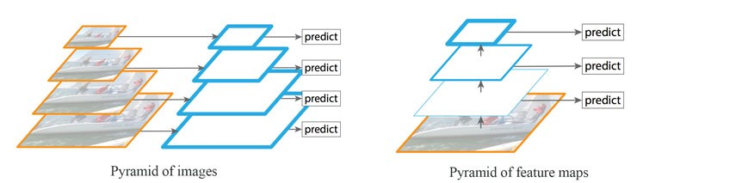
Image and Feature Pyramids
We can use a pyramid of the same image at different scales to detect objects (the left diagram below). However, processing multiple scale images is time consuming and the memory demand is too high to be trained end-to-end simultaneously.
Alternatively, we create a pyramid of feature and use them for object detection (the right diagram). However, feature maps closer to the image layer are composed of low-level features that are not effective for accurate object detection.

Slide 14
Neck - FPN
Feature Pyramid Network (FPN) is a feature extractor designed for such pyramid concept with accuracy and speed in mind.
It replaces the feature extractor of detectors like Faster R-CNN and generates multiple feature map layers (multi-scale feature maps) with better quality information than the regular feature pyramid for object detection.
Naturally leverages the pyramidal shape of a ConvNet’s feature hierarchy while creating a feature pyramid that has strong semantics at all scales.

Slide 15
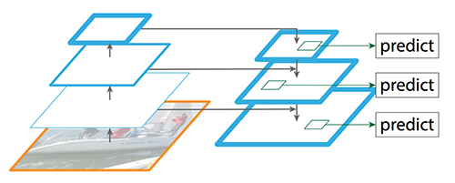
New architecture: combining semantically strong features with semantically weak features via a top-down pathway and lateral connection.
Predictions are made independently at all levels.

Slide 16
FPN is constructed with:
Bottom-up pathway
Top-down pathway
Lateral connections

Slide 17
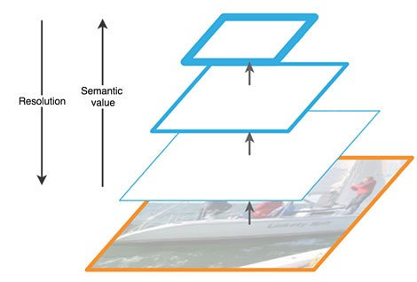
Bottom-up pathway
The bottom-up pathway uses convolutional networks for feature extraction.
As we go up, the spatial resolution decreases. With more high-level structures detected, the semantic value for each layer increases.

Slide 18
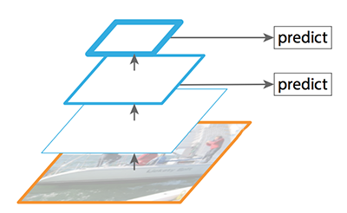
Bottom-up in SSD
SSD makes detection from multiple feature maps. However, the bottom layers are not selected for object detection.
They are in high resolution but the semantic value is not high enough to justify its use as the speed slow-down is significant.
So SSD only uses upper layers for detection and therefore performs much worse for small objects.

Slide 19
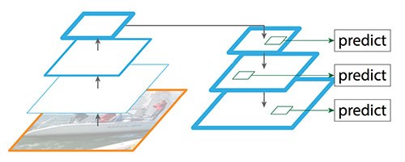
Top-down pathway
FPN provides a top-down pathway to construct higher resolution layers from a semantic rich layer.

Slide 20
Lateral Connections
While the reconstructed layers are semantic strong but the locations of objects are not precise after all the downsampling and upsampling.
We add lateral connections between reconstructed layers and the corresponding feature maps to help the detector to predict the location betters.
It also acts as skip connections to make training easier (similar to what ResNet does).

Slide 21
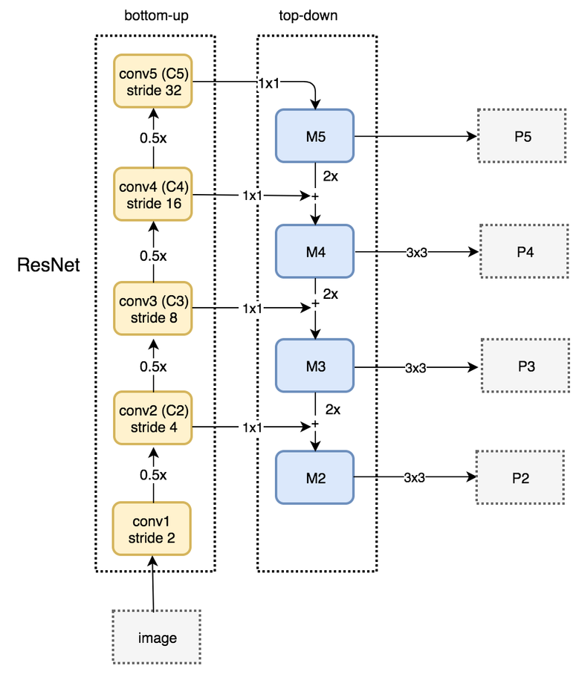
The complete picture
The bottom-up pathway uses ResNet to construct the bottom-up pathway.
It is composed of many convolution modules (convi for i equals 1 to 5) and each has many convolutional layers. As we move up, the spatial dimension is reduced by 1/2 (i.e. double the stride).
The output of each convolution module is labeled as Ci and later used in the top-down pathway.

Slide 22
The complete picture
We apply a 1 × 1 convolution filter to reduce C5 channel depth to 256-d to create M5. This becomes the first feature map layer used for object prediction.
As we go down the top-down path, we upsample the previous layer by 2 using nearest neighbors upsampling. We again apply a 1 × 1 convolution to the corresponding feature maps in the bottom-up pathway. Then we add them element-wise.
We apply a 3 × 3 convolution to all merged layers. This filter reduces the aliasing effect when merged with the upsampled layer.

Slide 23
The complete picture
We repeat the same process for P3 and P2. However, we stop at P2 because the spatial dimension of C1 is too large. Otherwise, it will slow down the process too much.
Because we share the same classifier and box regressor of every output feature maps, all pyramid feature maps (P5, P4, P3 and P2) have 256-d output channels.

Slide 24
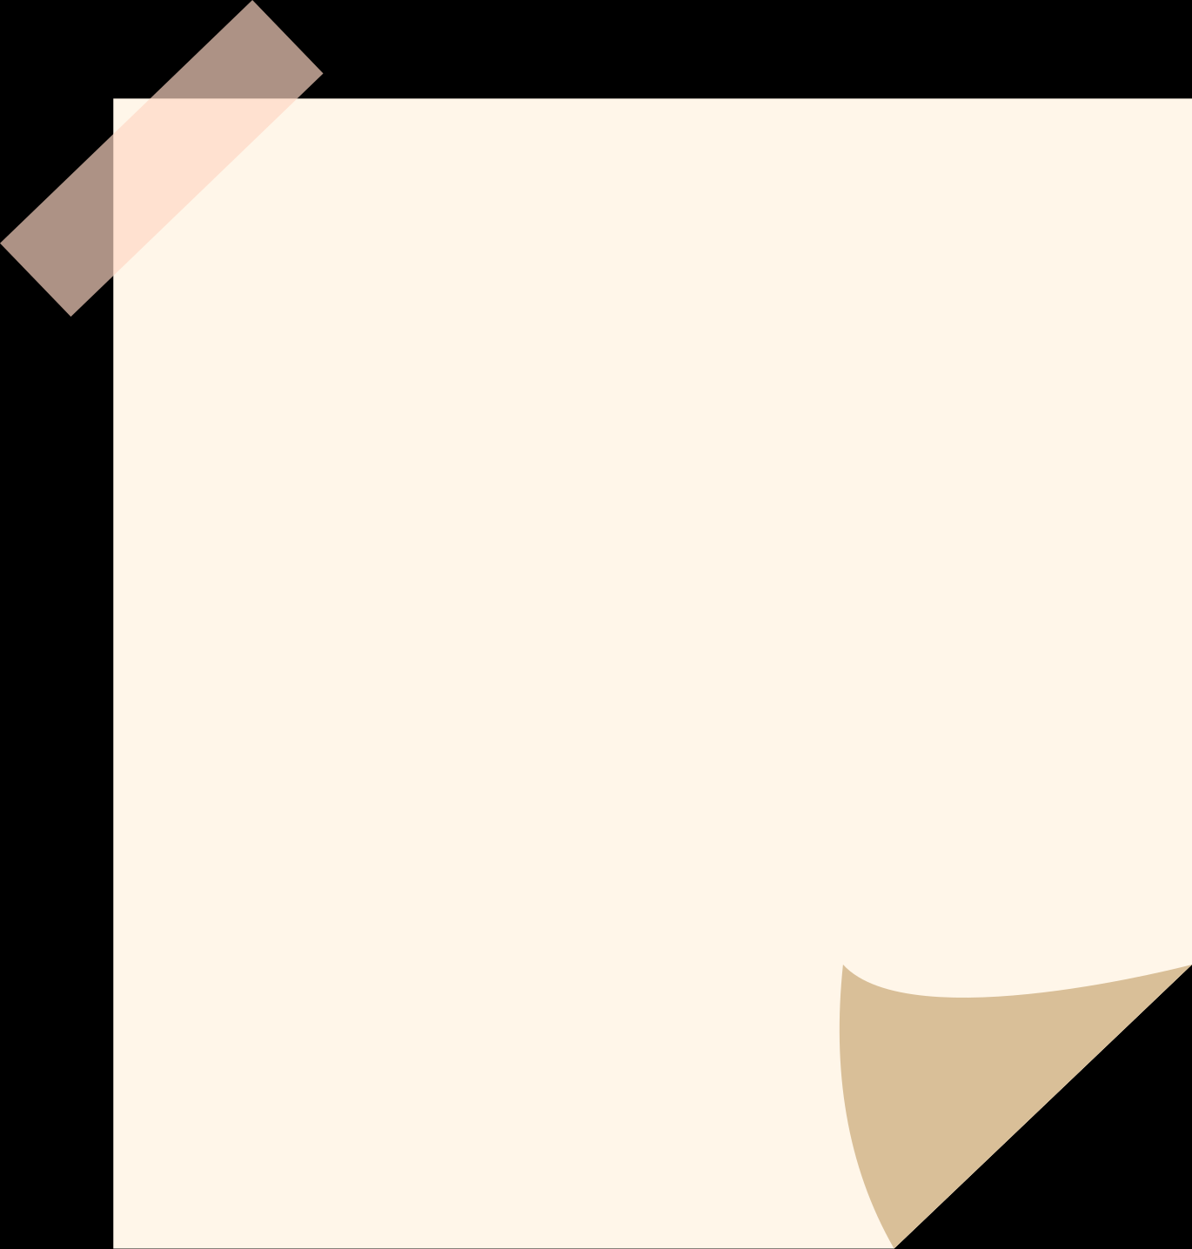
Notes
FPN is not an object detector by itself.
It is a feature extractor that works with object detectors.
FPN is independent to the backbone. And it can be used for:
Region Proposal Network
Object detector
Instance Segmentation

Slide 25
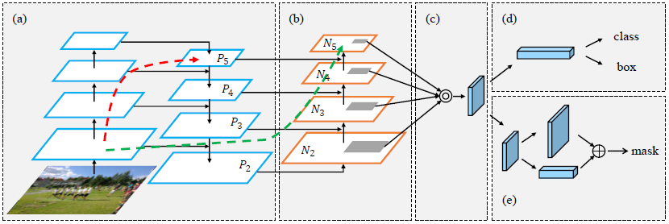
Neck - PANet
PANet is present in the neck of the YOLOv4 model and it is mainly incorporated in the model to enhance the process of instance segmentation by preserving spatial information.
The reason why PANet is chosen for instance segmentation in YOLOv4 is because of its ability to preserve spatial information accurately which helps in proper localization of pixels for mask formation.

Slide 26
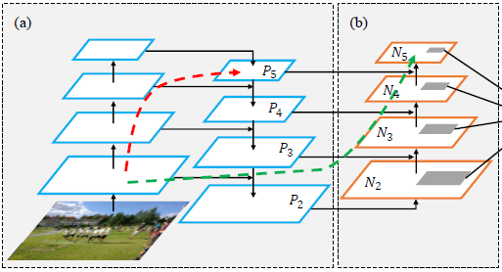
Bottom-up Path Augmentation
As the image passes through the various layers of the neural network, the complexity of the features increases and the spatial resolution of the image decreases concurrently. Due to this, the pixel-level masks cannot be identified accurately by the high level features.
The FPN, which is used in YOLOv3, uses a top-down path to extract and combine semantically rich features with the precise localization information. But for producing masks for large objects, this technique can be excessively lengthy as the spatial information may need to be propagated to hundreds of layers.

Slide 27
Bottom-up Path Augmentation
PANet on the other hand, takes an additional bottom-up path to the top-down path taken by FPN.
This helps in shortening that path by using clean lateral connections from the lower layers to the top ones.
This is called the “shortcut” connection which is only about 10 layers.

Slide 28
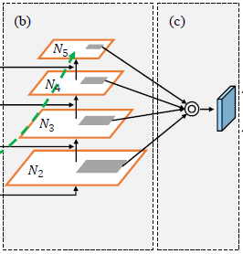
Adaptive Feature Pooling
Previously used techniques like the Mask-RCNN used features from a single stage to make mask predictions.
It used ROI Align Pooling to extract features from the higher levels if the region of interest was large.
Although quite accurate, this could still lead to undesired results as sometimes two proposals with as minute as 10-pixel differences can be assigned to two different layers, whereas they are in fact quite similar proposals.

Slide 29
Adaptive Feature Pooling
To avoid this, PANet uses features from all the layers, and lets the network decide which ones are useful.
It performs ROI Align operation on each feature map to extract the features for the object.
This is followed by an element-wise max fusion operation to enable the network to adapt new features.

Slide 30
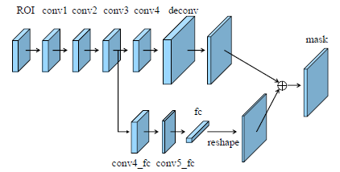
Fully Connected Fusion
In Mask-RCNN, Fully Convolutional Network (FCN) is used instead of the fully-connected layers because it preserves the spatial information and reduces the number of parameters in the network.
However, since the parameters are shared for all the spatial positions, the model doesn’t actually learn how to use pixel locations for making predictions; it will by default show sky in the top part of the image and roads in the bottom part.

Slide 31
Fully Connected Fusion
Fully-connected layers, on the other hand, are location sensitive and can adapt to different spatial locations.
PANet uses information from both of these layers to provide a more accurate mask prediction.

Slide 32
Fully Connected Fusion
Fully-connected layers, on the other hand, are location sensitive and can adapt to different spatial locations.
PANet uses information from both of these layers to provide a more accurate mask prediction.

Slide 33
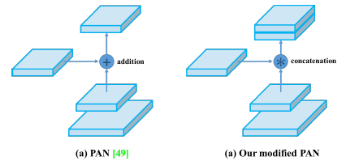
Modifications for YOLOv4
PANet conventionally adds the neighboring layers together for doing mask predictions using the adaptive feature pooling.
However, this approach is slightly twisted when PANet is employed in YOLOv4, such that instead of adding the neighbouring layers, a concatenation operation is applied on them which improves the accuracy of predictions.

Slide 34
Head
Takes in features from the neck along with the bounding box predictions.
Performs classification along with regression .
We have two-stage detectors and one stage-detectors
it basically finds the region where the object might be present.

